Slide 1
Topic: Quadratic Functions
EQ: What are they and how do we solve them?

Slide 2
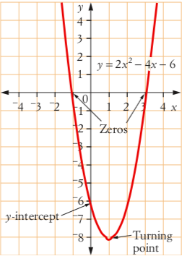

Topic: Quadratic Functions
EQ: What are quadratic function and how do they differ from linear functions?
What we know: A Quadratic Function is an equation that has the form
They won’t always look exactly like that, but our job is to solve them. The four main strategies we’ll use/forms we’ll encounter:

Slide 3

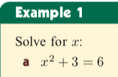

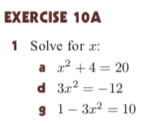
Topic: Quadratic Functions
EQ: What are quadratic function and how do they differ from linear functions?

Slide 4
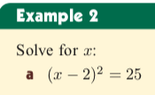
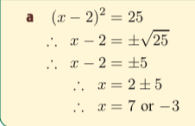

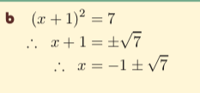
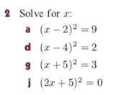
Topic: Quadratic Functions
EQ: What are quadratic function and how do they differ from linear functions?

Slide 5
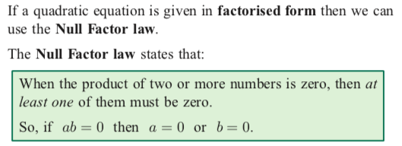
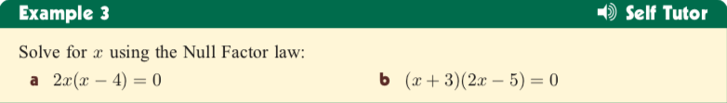
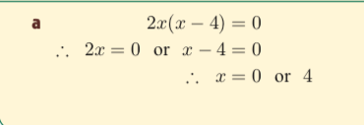
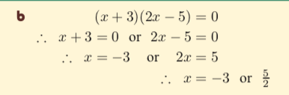
Topic: Quadratic Functions
EQ: What are quadratic function and how do they differ from linear functions?

Slide 6
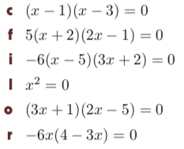
Topic: Quadratic Functions
EQ: What are quadratic function and how do they differ from linear functions?

Slide 7
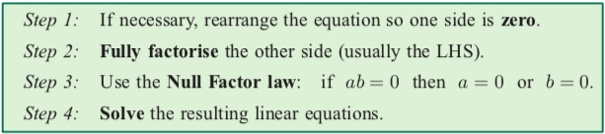
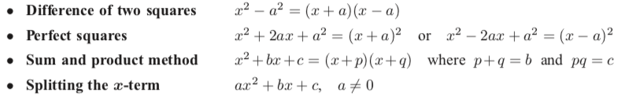
Topic: Quadratic Functions
EQ: What are quadratic function and how do they differ from linear functions?

Slide 8

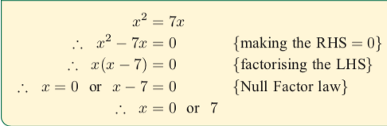

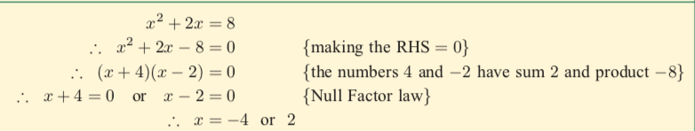

Topic: Quadratic Functions
EQ: What are quadratic function and how do they differ from linear functions?

Slide 9

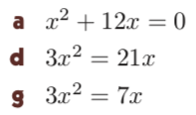
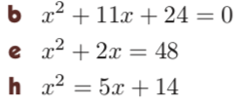
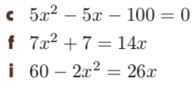
Topic: Quadratic Functions
EQ: What are quadratic function and how do they differ from linear functions?

Slide 10
Topic: Quadratic Functions
EQ: What are quadratic function and how do they differ from linear functions?
Learning Aim
We are learning to change quadratic expressions x² + bx + c
into the completed square form (x + p)² + q
Success Criteria
I can express a quadratic expression in completed square form (ALL)
I can check that my answers are correct by multiplying out and simplifying (MOST)
I can identify minimums by using the ‘completed square form’. (SOME)

Slide 11
Today’s Goal
Factorise and expand quadratics and complete the square to:
Find zeroes (or roots, or x-intercepts. Different names for the same thing)
Find y-intercept (the y-value when x = 0)
Find the coordinates of the vertex, using two different methods (which ever is easier for you)

Slide 12
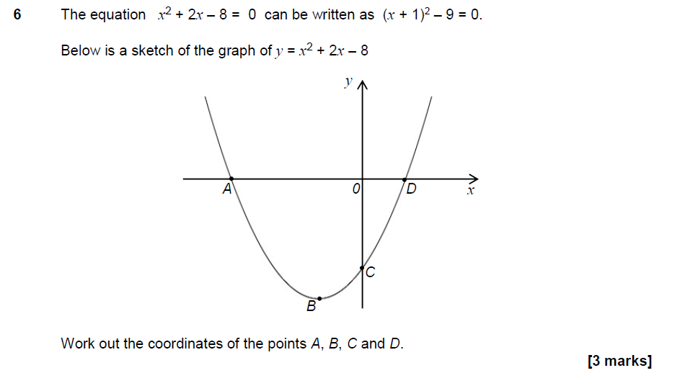
Completing the square: exam style question
Hint for A & D:
y= when the curve crosses the x-axis
Hint for C:
x= when the curve crosses the y-axis
Keywords: quadratic, coefficient, squared, complete the square, minimum point

Slide 13
Completing the Square
This number will be half the coefficient of x
x² + 4x + 4 = 0
Subtract the number in the brackets squared
(x+2)²
-2²
+ 4 = 0
(x+2)²
-4
+ 4 = 0
(x+2)²
= 0
x = -2
Keywords: quadratic, coefficient, squared, complete the square, minimum point

Slide 14
Completing the Square
This number will be half the coefficient of x
x² + 4x + 3 = 0
Subtract the number in the brackets squared
(x+2)²
-2²
+ 3 = 0
(x+2)²
-4
+ 3 = 0
(x+2)² -1 = 0
Can you mentally figure out what the 2 answers for x are?

Slide 15

Completing the Square
This number will be half the coefficient of x
x² + 10x + 10=0
Subtract the number in the brackets squared
(x+5)²
-5²
+ 10
=0
(x+5)²
-25
+ 10
=0
(x+5)²
-15
=0
Don’t forget there will be a positive and negative answer here
(x+5)²
=
15
Square root both sides
x+5
=
15
+
-
x
=
15
-5
+
-

Slide 16
x² + 6x + 10
Extension
Expand and simplify to check your answer
(x+6)² + 1
(x+3)² + 10
A)
B)
(x+3)² - 1
(x+3)² + 1
C)
D)
Keywords: quadratic, coefficient, squared, complete the square, minimum point

Slide 17
x² + 10x + 24
Extension
Expand and simplify to check your answer
(x+5)² +1
(x+5)² -1
A)
B)
(x+5)² -2
(x+5)² +4
C)
D)
Keywords: quadratic, coefficient, squared, complete the square, minimum point

Slide 18
Completing the Square
This number will be half the coefficient of x
x² + 8x + 2=0
Subtract the number in the brackets squared
(x+4)²
-4²
+ 2
=0
(x+4)²
-16
+ 2
=0
(x+4)²
-14
=0
Don’t forget there will be a positive and negative answer here
(x+4)²
=
14
Square root both sides
x+4
=
14
+
-
x
=
14
-4
+
-

Slide 19
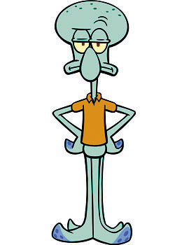
Completing the Square
This number will be half the coefficient of x
x² + 14x + 56=0
Subtract the number in the brackets squared
(x+7)²
-7²
+ 56
=0
(x+7)²
-49
+ 56
=0
We can stop here, we cannot find the square root of a negative, this equation has no solutions
(x+7)²
+ 7
=0
(x+7)²
=
-7
Square root both sides
x+7
=
-7

Slide 20

Practise Questions
Solve the following quadratic equations:
x²+8x-9=0
x²+6x-10=0
x²+10x-9=0
x²+6x-7=0
x²-10x+3=0

Slide 21
You may have used the factorising to solve
Eg solve and hence sketch
ie when y=0, x=-5 or 7
What do these solutions tell you about the graph of
-5
7
These solutions represent the points where the graph crosses x-axis:
Keywords: quadratic, coefficient, squared, complete the square, minimum point

Slide 22
Completing the square - Minimum Points
(x + 5)² – 15 = 0 Minimum at (-5, -15)
(x - 4)² – 11 = 0 Minimum at (4, -11)
(x - 7)² + 58 = 0 Minimum at (7, 58)
(x + p)² + q = 0 Minimum at (-p, q)
(x - p)² + q = 0 Minimum at (p, q)
Keywords: quadratic, coefficient, squared, complete the square, minimum point

Slide 23

Finding the Axis of Symmetry
You can find the Axis of Symmetry of any quadratic equation by using the formula
Let’s take a look at those equations again.
To find the coordinates of the vertex, plug the value of x into the original function .
a = 2, b = -4, c = 0
a = -2, b = -4, c = 0
vertex
(1, -2)
vertex
(-1, 2)

Slide 24
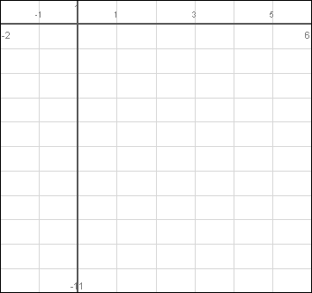
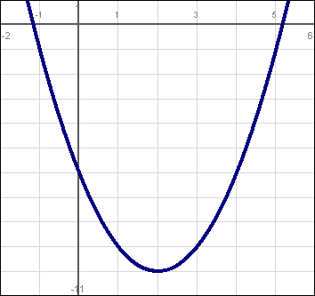
Graphing a Quadratic Equation Using a Table of Values
Graph
in the interval
Axis of
Symmetry
x = 2
That was easy
Vertex
(2, -10)

Slide 25
Completing the square: exam style question
Hint for A & D:
y= when the curve crosses the x-axis
Hint for C:
x= when the curve crosses the y-axis
Keywords: quadratic, coefficient, squared, complete the square, minimum point

Slide 26
Practise Questions
Solve the following quadratic equations:
x²-8x+1=0
x²+12x-5=12
4x²+8x-12=0
3x²+8x-9=0
5x²+20x-30=15

